Slide 1
Quantum performance metrics
Rajesh Sathya Kumar

Slide 2
CIRCUIT DEPTH
The length of the longest path from the input to output or the minimum amount of time taken to execute the circuit (assuming every gate operation are performed in same time-step)
CIRCUIT WIDTH
The circuit width is the total number of input qubits and bits used in the circuit.
QUANTUM VOLUME
It is defined as the average performance on a set of random circuits. If a quantum computer can execute an algorithm successfully (error-free) with n qubits, its quantum volume is 2^n.

Slide 3
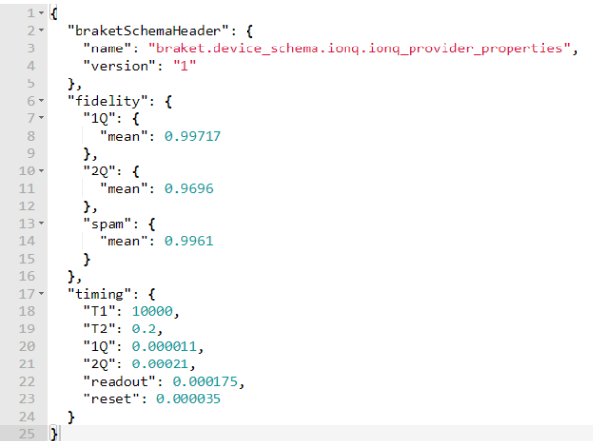
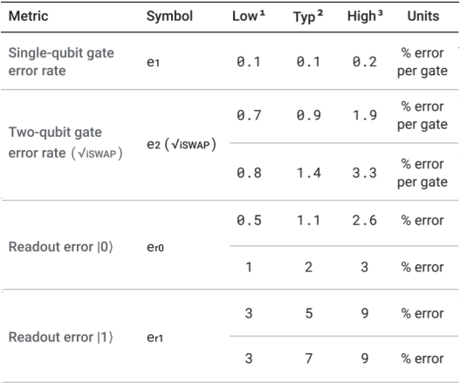
Component-level Performance Metrics
Fig1: Component level benchmark by Amazon bracket for IonQ QPU [1]
Fig2: Component level benchmark by Google for its Weber Device [1]

Slide 4
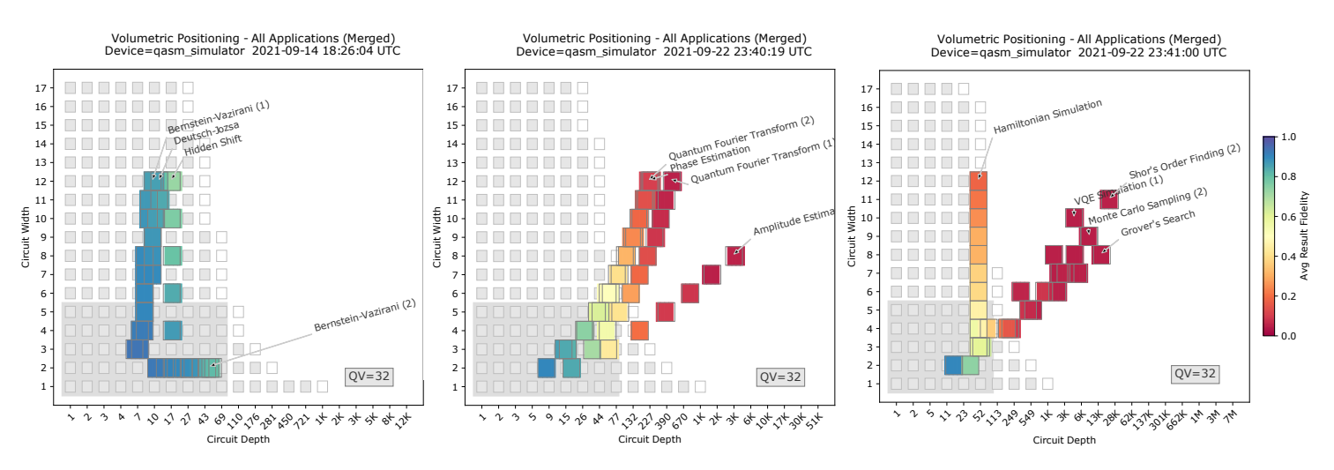
Application oriented performance benchmark
Fig 3: Application oriented performance benchmark for Tutorial, subroutine and functional applications [1]

Slide 5
Current work:
Implemented the following algorithms in Qiskit and Pennylane:
Quantum Fourier Transform
Grover’s Search Algorithm
Variational Quantum Eigensolver
Shor’s Order Finding
Hybrid Deep neural networks
Next steps:
Reading more literatures on other existing performance metrics and noise models
Implementing the performance metrics with different simulators for the algorithms listed above
Reading Part III, chapter 8, 9, 10, 11 on Quantum noise and error correction from Quantum Information Book by Nielson and Chung

Slide 6
References:
Application-Oriented Performance Benchmarks for Quantum Computing, Thomas Lubinski, Sonika Johri, Paul Varosy, Jeremiah Coleman, Luning Zhao, Jason Necaise, Charles H. Baldwin, Karl Mayer, and Timothy Proctor, arXiv:2110.03137

